Slide 1
Introduction to iOS App Development Environment
Sisoft Technologies Pvt Ltd
SRC E7, Shipra Riviera Bazar, Gyan Khand-3, Indirapuram, Ghaziabad
Website: www.sisoft.in Email:info@sisoft.in
Phone: +91-9999-283-283

Slide 2
Requirements to develop an iOS app
Macintosh ( OS X)
Download and install X-Code
Languages: Objective –C /Swift
Register with apple developer account
http://developer.apple.com/membercenter
Enroll for iOS Developer programe

Slide 3
Mac OS X Versions
Version 10.4: "Tiger"
Version 10.5: "Leopard"
Version 10.6: "Snow Leopard"
Version 10.7: "Lion"
Version 10.8: "Mountain Lion"
Version 10.9: "Mavericks"
Version 10.10: "Yosemite"
Version 10.11: "El Capitan"

Slide 4
Using MAC OS-X
Sisoft Technologies Pvt Ltd
SRC E7, Shipra Riviera Bazar, Gyan Khand-3, Indirapuram, Ghaziabad
Website: www.sisoft.in Email:info@sisoft.in
Phone: +91-9999-283-283

Slide 5
Like a Windows interface, the Mac begins at the Desktop

Slide 6
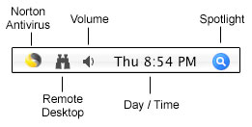
“Where is the Start bar ?”
Instead,
Macs have a menu bar at the top of the screen. The far right side of it is similar
to the System Tray on a Windows machine, displaying the time and icons of
other programs running in the background. Here’s the right end of my menu bar:

Slide 7
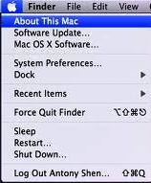
Apple Menu
At the far left side of the menu bar is a small apple icon
Click on this, and notice that “Sleep,” “Restart,” and “Shut Down” are three options near the bottom of the menu
You will return to this menu and click on these when you want to reboot or turn off the computer

Slide 8
The Dock
The Dock is an area where you can place frequently used Icons for easy access
More than likely, the bar appears at the bottom of your screen, although it can be modified to reside on the left or right side
Some Macs also have the Dock set to “hide” when it is not in use. If you don’t see it, place the cursor at the bottom, left, or right of the screen for a few seconds to “unhide” the Dock

Slide 9
System Preferences (the Mac Control Panel)
“System Preferences” is the Mac version of the Control Panel
You can find the icon in the Dock, and it’s also listed in the Apple Menu
System Preferences allows you to adjust the settings for different areas of the Mac from one convenient place

Slide 10
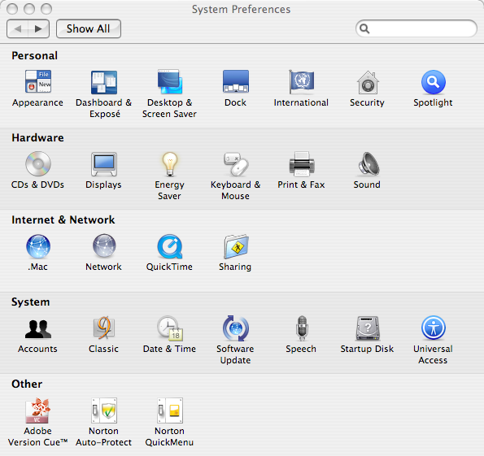

Slide 11
Trash
Trash icon is located on the far right side of the Dock
Like the Recycle Bin in Windows, files that are placed here are not automatically deleted, so don’t worry if you accidentally throw out something important
To retrieve a file, click on the Trash icon and its contents will appear in a window. Drag the item you want to retrieve onto the Desktop or back to its original folder

Slide 12
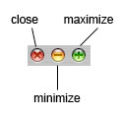
WORKING WITH WINDOWS
Macintosh windows can be controlled just like those on a PC. However, the buttons and menus have a slightly different layout
Closing, Minimizing, Maximizing
Open any window three buttons on the very top left

Slide 13
Resizing and Moving Windows
Look at the bottom right corner of the window
Below the scroll bar (which operates just as on a PC), you’ll notice a triangle made up of four lines
This is used to resize the window. Click on the triangle and drag it to adjust the window’s size and shape

Slide 14
Menus
On a PC, each application and folder has its own menu. Macs operate slightly differently
The screen will always display only one menu bar, found at the top of the screen, which changes depending on what program you are using
Before any programs are launched, the menu should say “Finder” just to the right of the Apple

Slide 15
WHERE ARE ALL THE PROGRAMS?
1- Macintosh HD:
The first (and possibly only) icon you’ll see on the Mac desktop is labeled “Macintosh HD” (HD stands for hard drive)
It’s usually in the upper right corner and is similar to the “My Computer” icon in Windows
Double-click on the icon to open a window that allows you to navigate to various folders on the hard drive.
Click on “Applications” in the far left column and a list of installed programs will appear

Slide 16
2-Finder
Finder is similar to Windows Explorer
To open Finder, click on its icon in the dock, usually located on the far left
This should take you to the same window as the “Macintosh HD” icon, although it may have a different folder highlighted

Slide 17
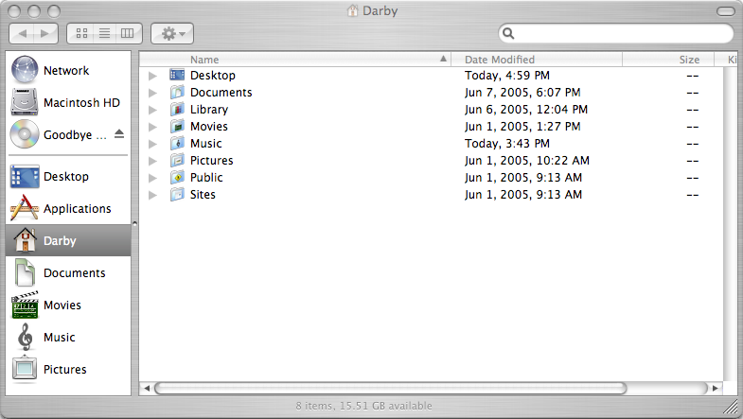

Slide 18
Navigating Folders

Slide 19
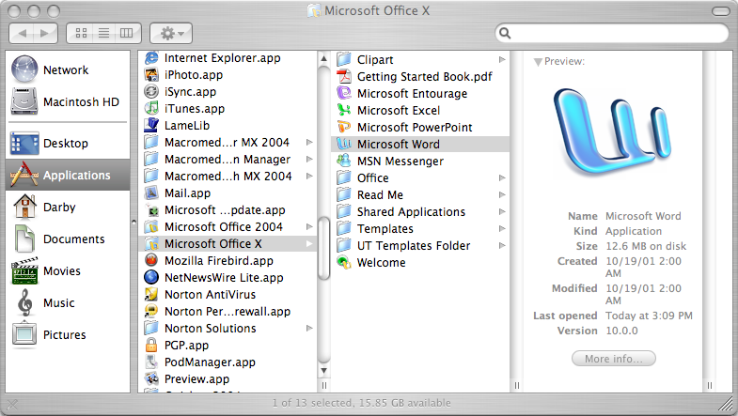

Slide 20
Spotlight
In the upper right corner of the menu bar is a small icon with a magnifying glass
This is Spotlight, a program that can search for programs, files, and folders quickly
Click on the icon and a text box will appear below

Slide 21
COMMON KEYBOARD SHORTCUTS
Refers to the command key(apple key)
Refers to the option/alt key
Refers to the shift key
Force quiet – Apple + Option + ESC
Right click – Control + mouse click
Cut – Apple + X
Copy – Apple + C
Paste – Apple + V
F9 – View all of the windows that are currently open
F10 – View all of the windows of the program that you’re currently using
F11 – Hide all windows
For more detail visit link:https://developer.apple.com/library/ios/documentation/ToolsLanguages/Conceptual/Xcode_Overview/About_Xcode/about.html#//apple_ref/doc/uid/TP40010215

Slide 22
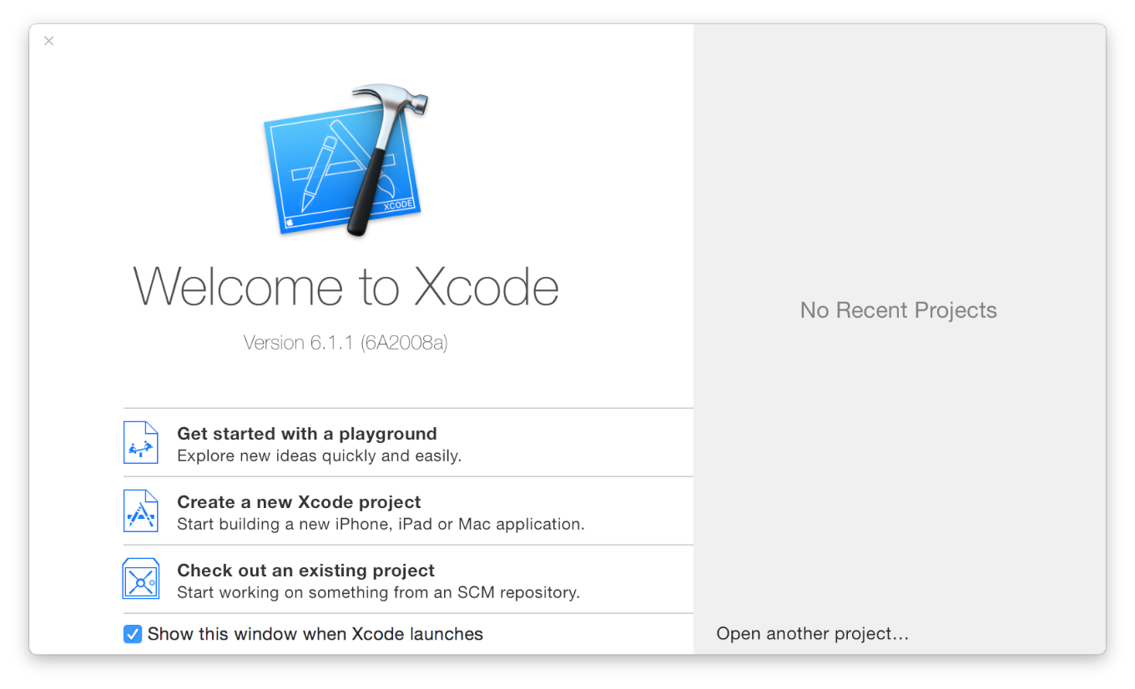
Open Xcode from the /Applications directory
The Xcode welcome window appears.

Slide 23
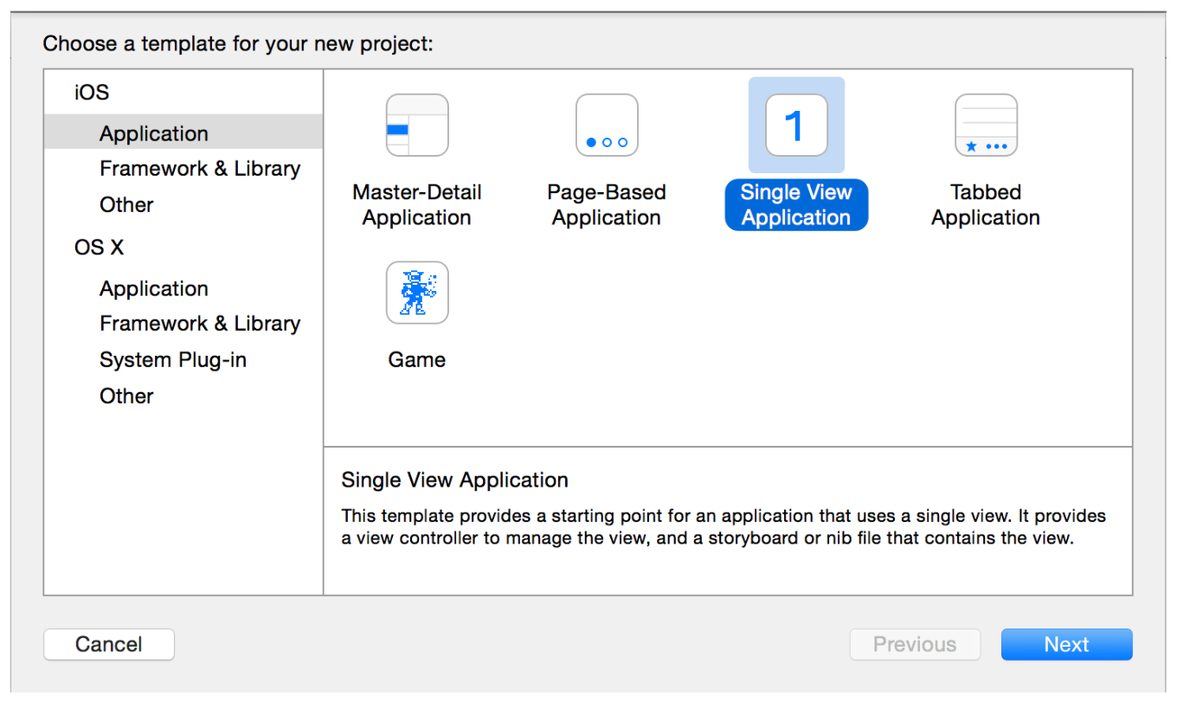
Create a new Xcode Project
Choose a Application for desired platform

